Slide 1

WEB 3, Session 5
GraphQL
Apollo Server

Slide 2
Agenda
Same-origin Policy
GraphQL
Apollo Server
GraphQL Client

Slide 3
Same-origin Policy (SOP)
Browsers are very strict about calling services from another origin (address and port)
Scenario:
You log in to your bank - mybank.com
In another tab you are logged in to - evilbankhackers.org
Because you are logged in, the evil bank hackers could in theory hijack your session and empty your bank account
Therefore, SOP doesn't allow a page on evilbankhackers.org to call services (RESTful or otherwise) on mybank.com
Note: this protection is in the browser. It protect end-users, not the service.

Slide 4
Origins
An origin consists of
protocol
host
port
These are different domains:
https://mydomain.dk:2348/
https://otherdomain.dk:2348/
https://mydomain.dk:2234/
http://mydomain.dk:2348/

Slide 5
Cross-Origin Resource Sharing (CORS)
CORS are rules you can set up to loosen SOP
Another scenario:
Your bank wants a new domain: myonlinebank.com
But the services are still on mybank.com
The bank sets up CORS headers on the responses from mybank.com
The browser can now know that myonlinebank is okay to call mybank
Note: This is not the server blocking calls from specific sites
It's the browser not allowing calls unless CORS is set up to allow it
Notes:
Protocol
Pre-flight

Slide 6

CORS in Express
gameserver.use((_, res, next) => {
res.header("Access-Control-Allow-Origin", "http://localhost:5173");
res.header("Access-Control-Allow-Headers",
"Origin, X-Requested-With, Content-Type, Accept");
res.header("Access-Control-Allow-Methods", "GET, POST, PATCH");
next();
});

Slide 7
Using cors middleware
app.use(cors({
origin: 'http://localhost:5173',
methods: ['GET', 'POST, OPTIONS']
}))

Slide 8
Using regular expressions
app.use(cors({
origin: /:\/\/localhost:/,
methods: ['GET', 'POST, OPTIONS']
}))

Slide 9
Dynamic origins
function dynamicOrigins(origin?: string) {
if (origin === undefined) return defaultOrigins
const portIndex = origin.lastIndexOf(':')
if (portIndex === -1) return defaultOrigins
const port = origin.slice(portIndex + 1)
return `http://localhost:${port}`
}
app.use(cors({
origin: (origin, callback) => callback(null, dynamicOrigins(origin)),
methods: ['GET', 'POST, OPTIONS']
}))

Slide 10
Agenda
Same-origin Policy
GraphQL
Apollo Server
GraphQL Client

Slide 11
GraphQL
A standard for making an interface
Often used for API gateways
Still need to implement the interface
We'll be using Apollo Server for that

Slide 12
GraphQL queries only ask for what they need
pending_games {
id
players
}

Slide 13
Scalar types
Int
Float
String
Boolean
ID
This is a GUID/UUID - a string not a number

Slide 14
GraphQL type
type PendingGame {
id: ID!,
pending: Boolean,
creator: String!,
players: [String!]!,
number_of_players: Int!
}

Slide 15
Arrays
Arrays are indicated by putting [] around the type: [String]
Example: players: [String!]!

Slide 16

!
! means NOT NULL: type Credentials {
username: String!
password: String!
}
! and arrays:
[String]! - the array is mandatory, but can contain nulls
[String!] - the array is optional, but can't contain nulls
[String!]! - the array is mandatory, and can't contain nulls

Slide 17
Referring to other types
type Score {
slot: String!,
score: Int
}
type ActiveGame {
id: ID!,
…
scores: [[Score!]!]!
}

Slide 18

Interfaces
interface Game {
id: ID!,
pending: Boolean!
}
type ActiveGame implements Game {
id: ID!,
pending: Boolean!
…
}
type PendingGame implements Game {…}

Slide 19
Unions
union Game = ActiveGame | PendingGame

Slide 20
Defining Queries and Mutations
Queries and Mutations are defined using 2 special types type Query and type Mutation
In order to make Queries and Mutations work, we need to implement resolvers
Queries can be either with or without parameters
Mutations can be without parameters, but will rarely be so
The parameters of Mutations need to be either primitive types or a special input type

Slide 21
type Query
type Query {
games: [ActiveGame!]!,
game(id: ID!): ActiveGame,
pending_games: [PendingGame!]!
pending_game(id: ID!): PendingGame
}

Slide 22

type Mutation
input BlogInput {
text: String!,
username: String!,
tags: [String!]
}
type Mutation {
createBlog(blog: BlogInput!): Blog,
addComment(blogId: ID!, comment: CommentInput!): Comment
}

Slide 23
Agenda
Same-origin Policy
GraphQL
Apollo Server
GraphQL Client

Slide 24

Apollo Server
Implements GraphQL based on
Type definitions (.sdl)
Resolvers
A resolver takes (most important)
parent - properties from parents (for resolver chaining)
args - properties from arguments
context - server-wide properties

Slide 25
Helper functions for the resolver
async function respond_with_error(err: ServerError): Promise<never> {
throw new GraphQLError(err.type)
}
async function pending_game(api: API, id: string)
: Promise<PendingGame | undefined> {
const res = await api.pending_game(id)
return res.resolve({
onSuccess: async g => g,
onError: async e => undefined
})
}

Slide 26

The Query Property of the resolver object
Query: {
async games() {
return games(api)
},
async game(_:any, params: {id: string}) {
return game(api, params.id)
},
…
async pending_game(id: string) {
return pending_game(api, id)
}
},

Slide 27
The Mutation property of the resolver object
Mutation: {
async join(_:any, params: {id: string, player: string}) {
return join(api, params)
},
…
},

Slide 28
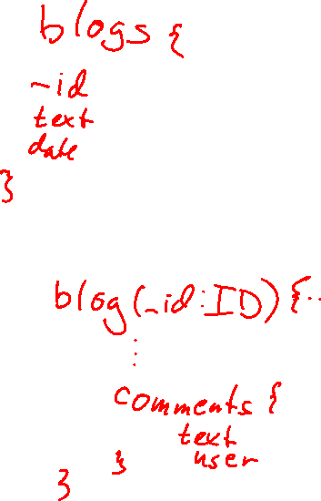
Resolver chaining case
type Comment {
text: String!,
user: String!,
likes: [String!]!
}
type Blog {
_id: ID!,
…
comments: [Comment!]!
}

Slide 29
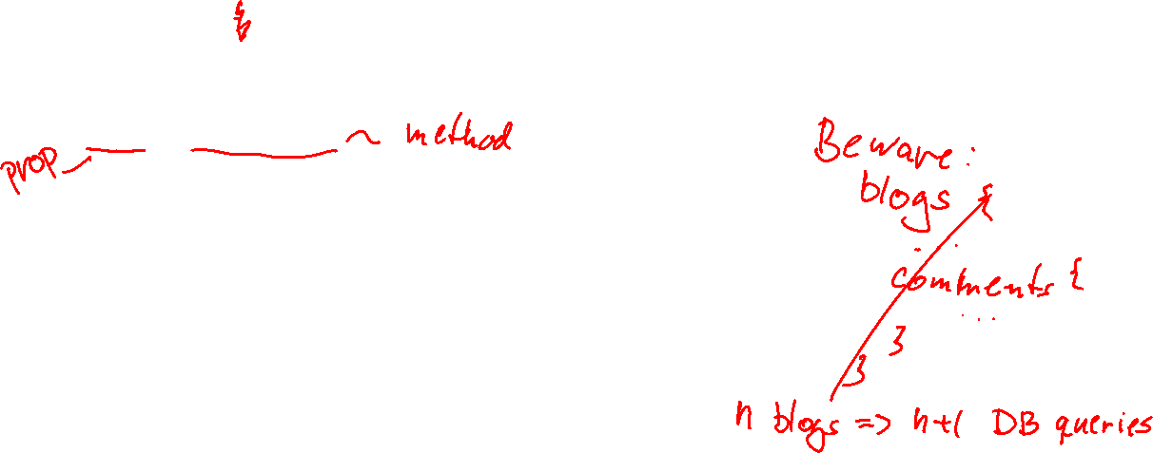
Resolver chaining
Query.blog()
Resolver for the blog query
Blog.comments()
Resolver for the comments property of blogs
Uses the parent parameter to look up the blog id
Chaining: Query.blog() --> Blog.comments()
When querying blogs
If any details from comments are requested
Calls Blog.comments()

Slide 30
Resolver for Chaining
export async function blogComment(parent) {
return runSession(db =>
commentsForBlog(db.collection("blogs"), parent._id)
)
}

Slide 31
Chaining resolver in the resolver object
Blog: {
comments: Resolver.blogComment
},

Slide 32
Type Resolver
Type resolvers are used when a type can be seen as ambiguous
This might be an interface with several implementations
It can also be a union type
The resolver is the same in either case

Slide 33
Type resolver in the resolver object
Game: {
__resolveType(obj:any) {
if (obj.pending)
return 'PendingGame'
else
return 'ActiveGame'
}
},

Slide 34
Agenda
Same-origin Policy
GraphQL
Apollo Server
GraphQL Client

Slide 35
GraphQL Clients
GraphQL runs over HTTP(S)
You can call it with
fetch
axios
RxJS
even XMLHttpRequest (God forbid)
You can also use a dedicated GraphQL Client
I use the ApolloClient (install @apollo/client)

Slide 36
Using fetch (I)
const query = `query PendingGame($id: String!) {
pending_game(id: $id) {
id
number_of_players
pending
creator
players
}
}`
const variables = {
'id': '3'
}

Slide 37
Using fetch (II)
const headers = {
'Content-Type': 'application/json',
Accepts: 'application/json'
}
const res = await fetch('/graphql', {
method: 'POST',
body: JSON.stringify({query, variables}),
headers})
const data = await res.json()

Slide 38

ApolloClient (I)
import {
ApolloClient,
HttpLink,
InMemoryCache,
gql } from "@apollo/client/core"
const httpLink = new HttpLink({ uri: 'http://localhost:4000/graphql'})
const client = new ApolloClient({
link: httpLink,
cache: new InMemoryCache(),
})

Slide 39
ApolloClient (II)
const query = `query PendingGame($id: String!) {
pending_game(id: $id) {
id
number_of_players
pending
creator
players
}
}`
const variables = {
'id': '3'
}

Slide 40
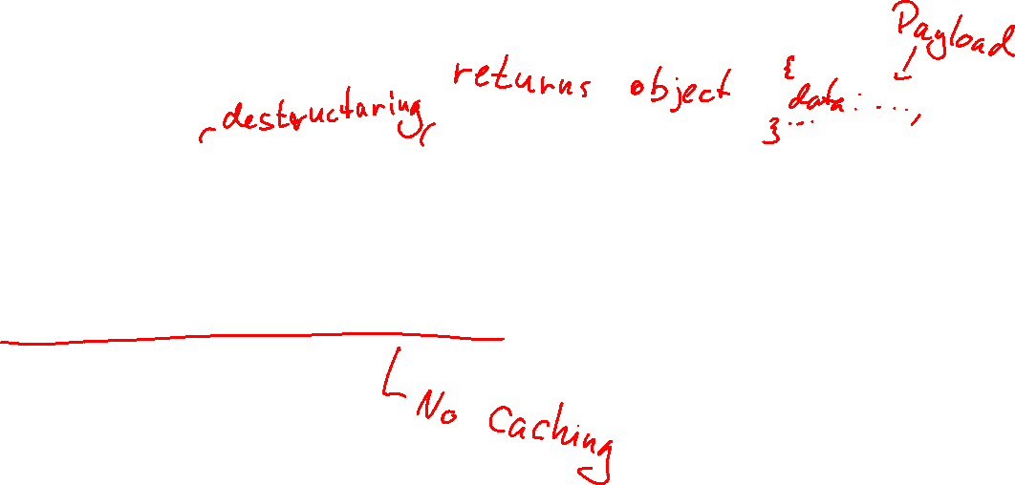
ApolloClient (III)
const { data } = await apolloClient.query({
query,
variables,
fetchPolicy: 'network-only' })

